Slide 1
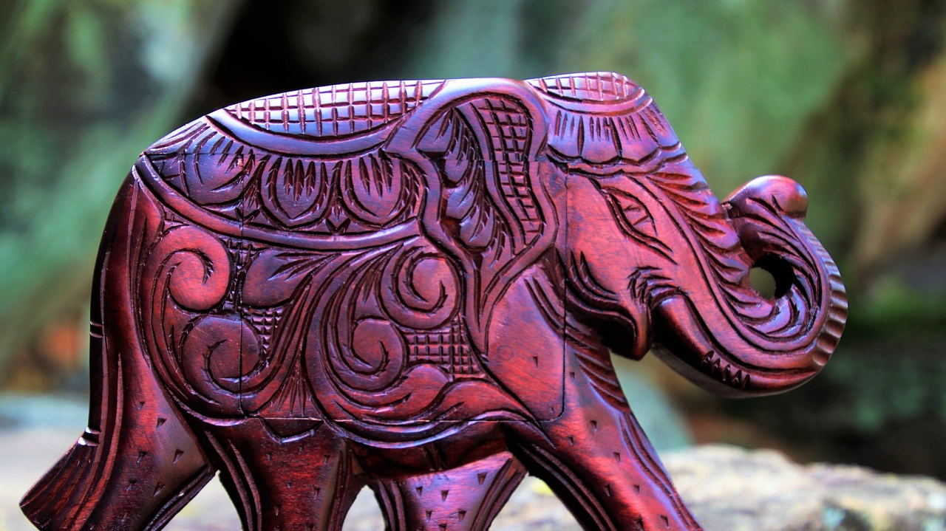
SRI LANKA
By: Iresh Thilakarathne

Slide 2
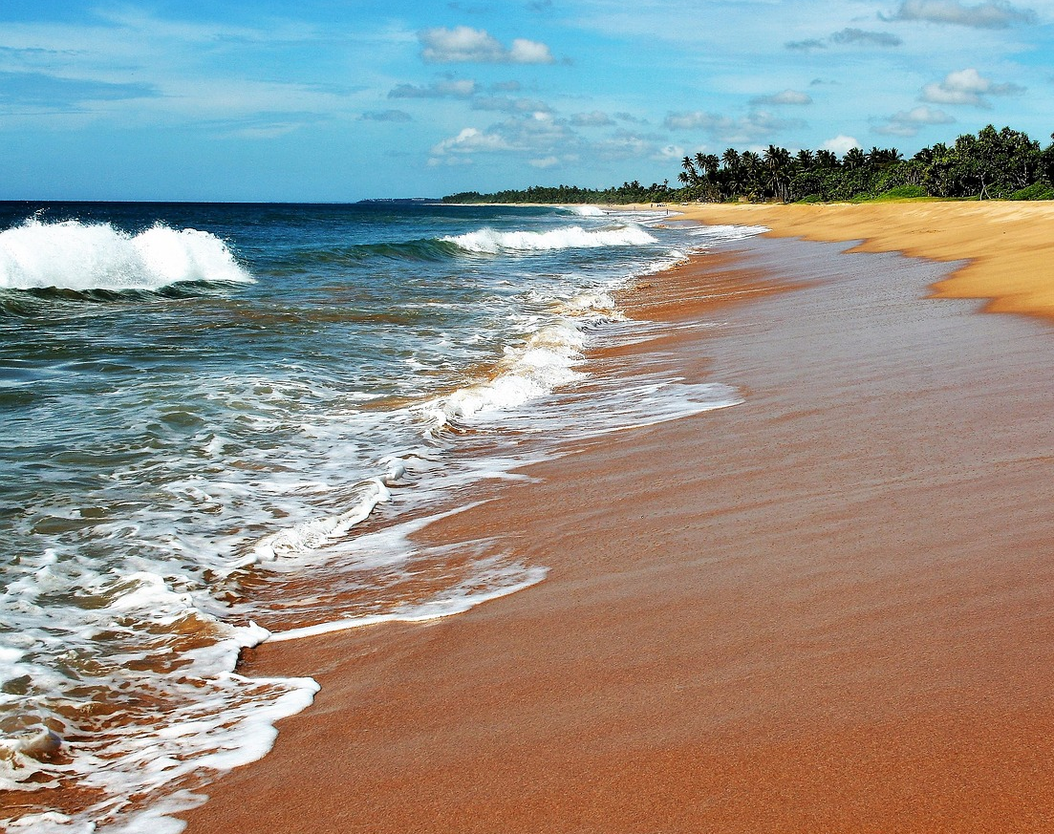
Sri Lanka is known as the “Pearl of the Indian Ocean”

Slide 3
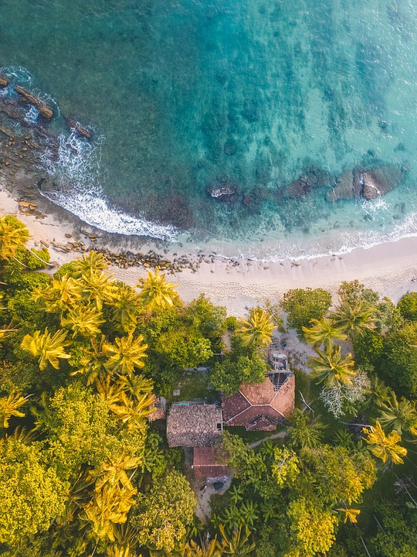
Names of Sri Lanaka
Tambapanni
Taprobane
Serendib
Ceylon

Slide 4
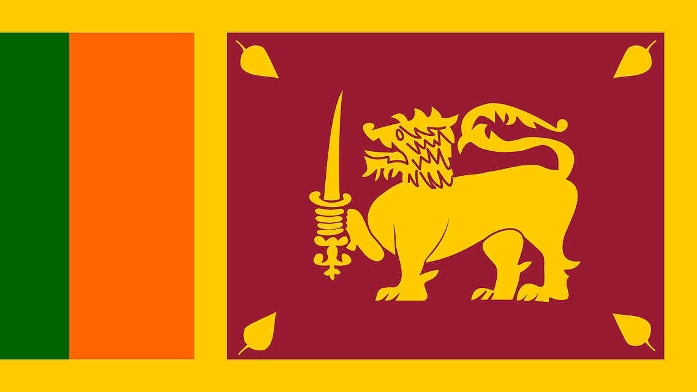
Facts about Sri Lanka…
Capital City: Sri Jayawardenapura Kotte
Largest City: Colombo
Population: Around 20 million
Number of Provinces: 9
Number of Districts: 25
Main Languages: Sinhala, Tamil

Slide 5
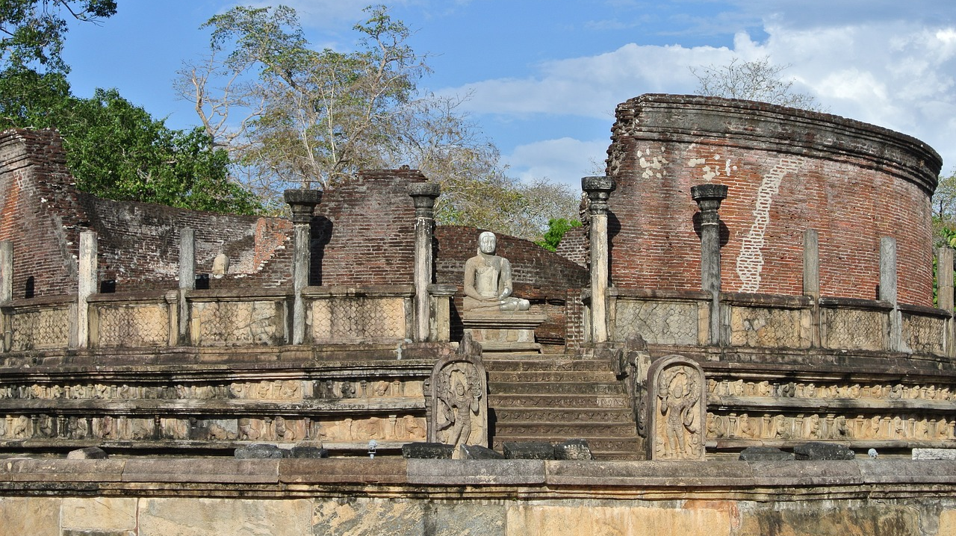
Places to Visit

Slide 6
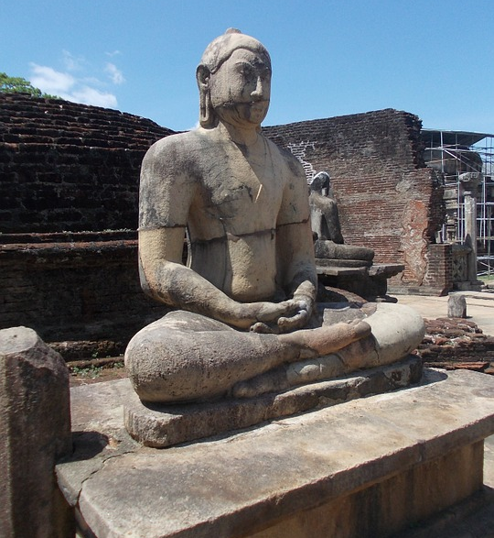
World Heritage Sites
Ancient City of Sigiriya
Ancient City of Anuradhapura
Ancient City of Polonnaruwa
Golden Temple of Dambulla

Slide 7
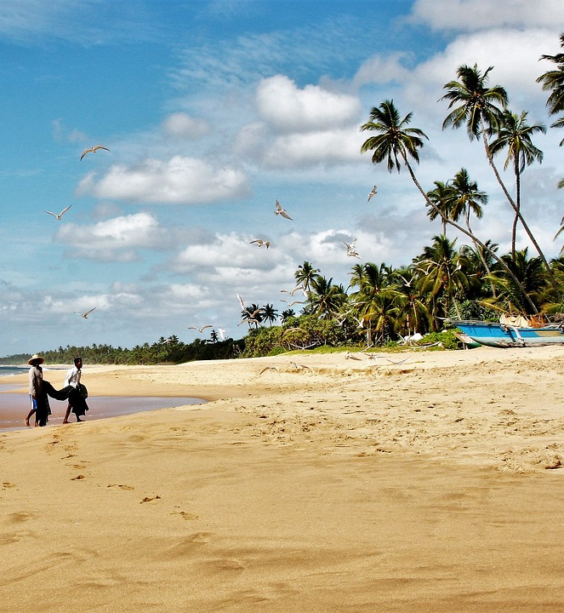
Beaches
Gallface
Arugambay
Hikkaduwa
Unawatuna
Nilaweli
Pasikuda
Marbel Beach
Jungle Beach

Slide 8
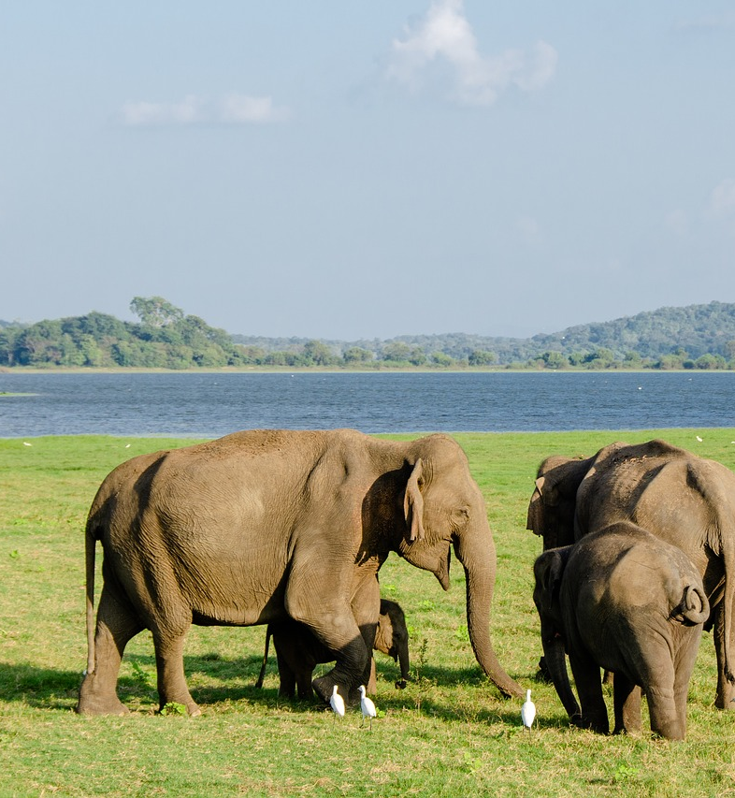
Wild Life
Yala
Wilpattu
Udawalawa
Minneriya
Kumana
Sinharaja
Gal Oya
Wasgamuwa

Slide 9
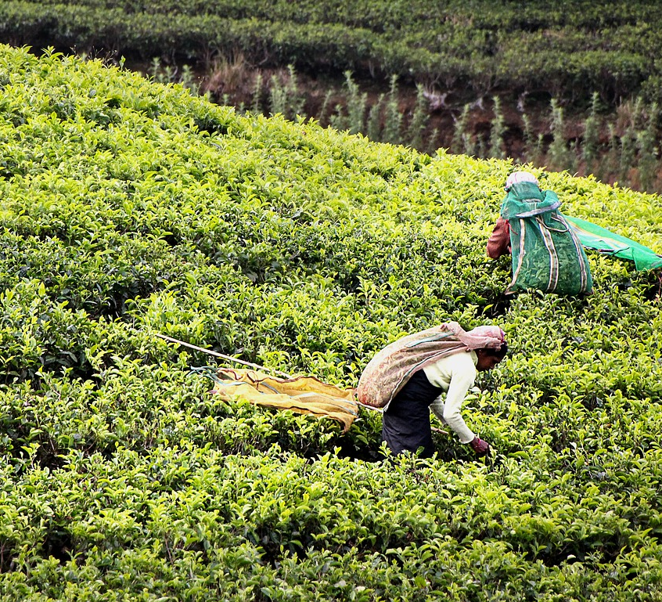
Plantation Economy
Mainly produces and exports Tea, Rubber, Coconut and Cinnamon

Slide 10
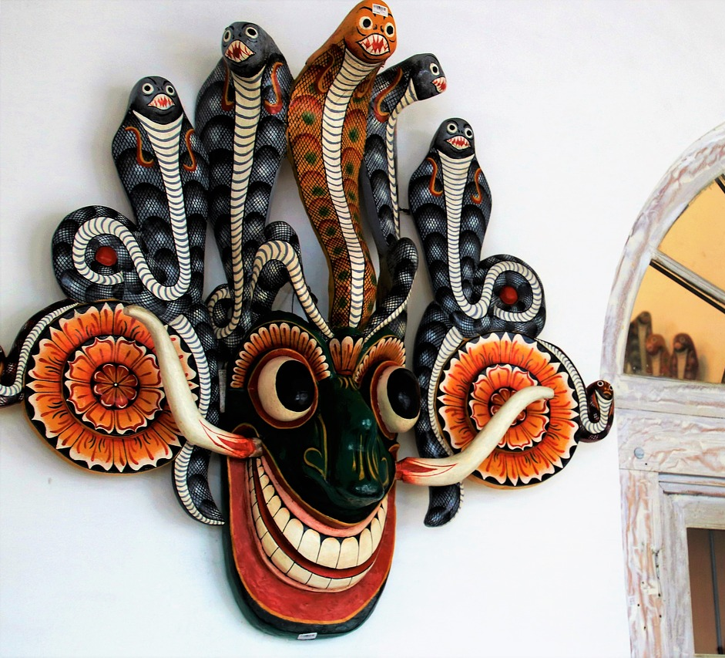
Thank You !

